Slide 1
Data Analytics

Slide 2
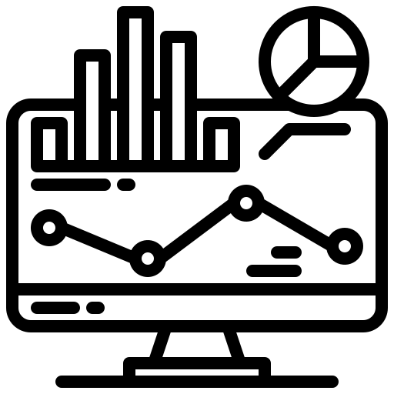
Infomineo has a unique approach to Data Analytics
Analytics
Traditional model
Infomineo model
Most Data Analytics companies provide standard models that they transpose from a client to another. Such models very often remain at Proof-Of-Concept stage, as integration with IT systems is not completed
Most Data Analytics providers are specialized in Data Visualization tools, e.g. Tableau, Power BI, etc.
Most providers work on a project basis – After project completion, the models can be hard for clients to maintain over time
Some providers retain rights on the Intellectual Property they generate
We are problem solvers, we need to understand your question or challenge and will find the data and models that answer your questions. The output is co-constructed with our client and not a model taken off the shelf
We have a multi capabilities team that can provide you an end-to-end approach from cleaning the data to visualizing the model output
We work on a retainer basis, we are an extension of your team, and make it easy to work with us, which 1/minimizes the time you spend on paperwork and 2/allows you to work with us on an iterative basis
The output of our work will become a knowledge asset of our client, who will hold the Intellectual Property of it

Slide 3
Infomineo offers a full suite of Data Analytics Services
Analytics
Three Levels of Analytics
Business oriented approach
Three areas of support
Scaling Data
Data Optimization: Collection, Cleaning, Pipeline Automation, etc.
Infomineo’s teams approach problems with business sense
Retained teams working in an iterative approach to ensure constant alignment with clients needs
Gathering data from internal and external sources; Assessing data quality; Processing data cleaning and wrangling
Data Engineering
Preparation
Describing Data
BI and Reporting (KPI, Ad hoc requests, etc.)
Data Visualization (Reports, Dashboards, etc.)
Business & Data Understanding
Agile Methodology
Designing, building and maintaining self-service analytics tools
Data
Analysis
Visualization
Delivery Management
Modeling Data
Data exploration, Statistical Analysis, Predictive/Prescriptive, Model Building/Tuning, etc.
Building predictive and prescriptive models, incl. training/retraining and deployment
Data
Science
Modeling
Projects are handled until last step and beyond: versioning, unit tests, model validation, code reviews, documentation, etc.

Slide 4



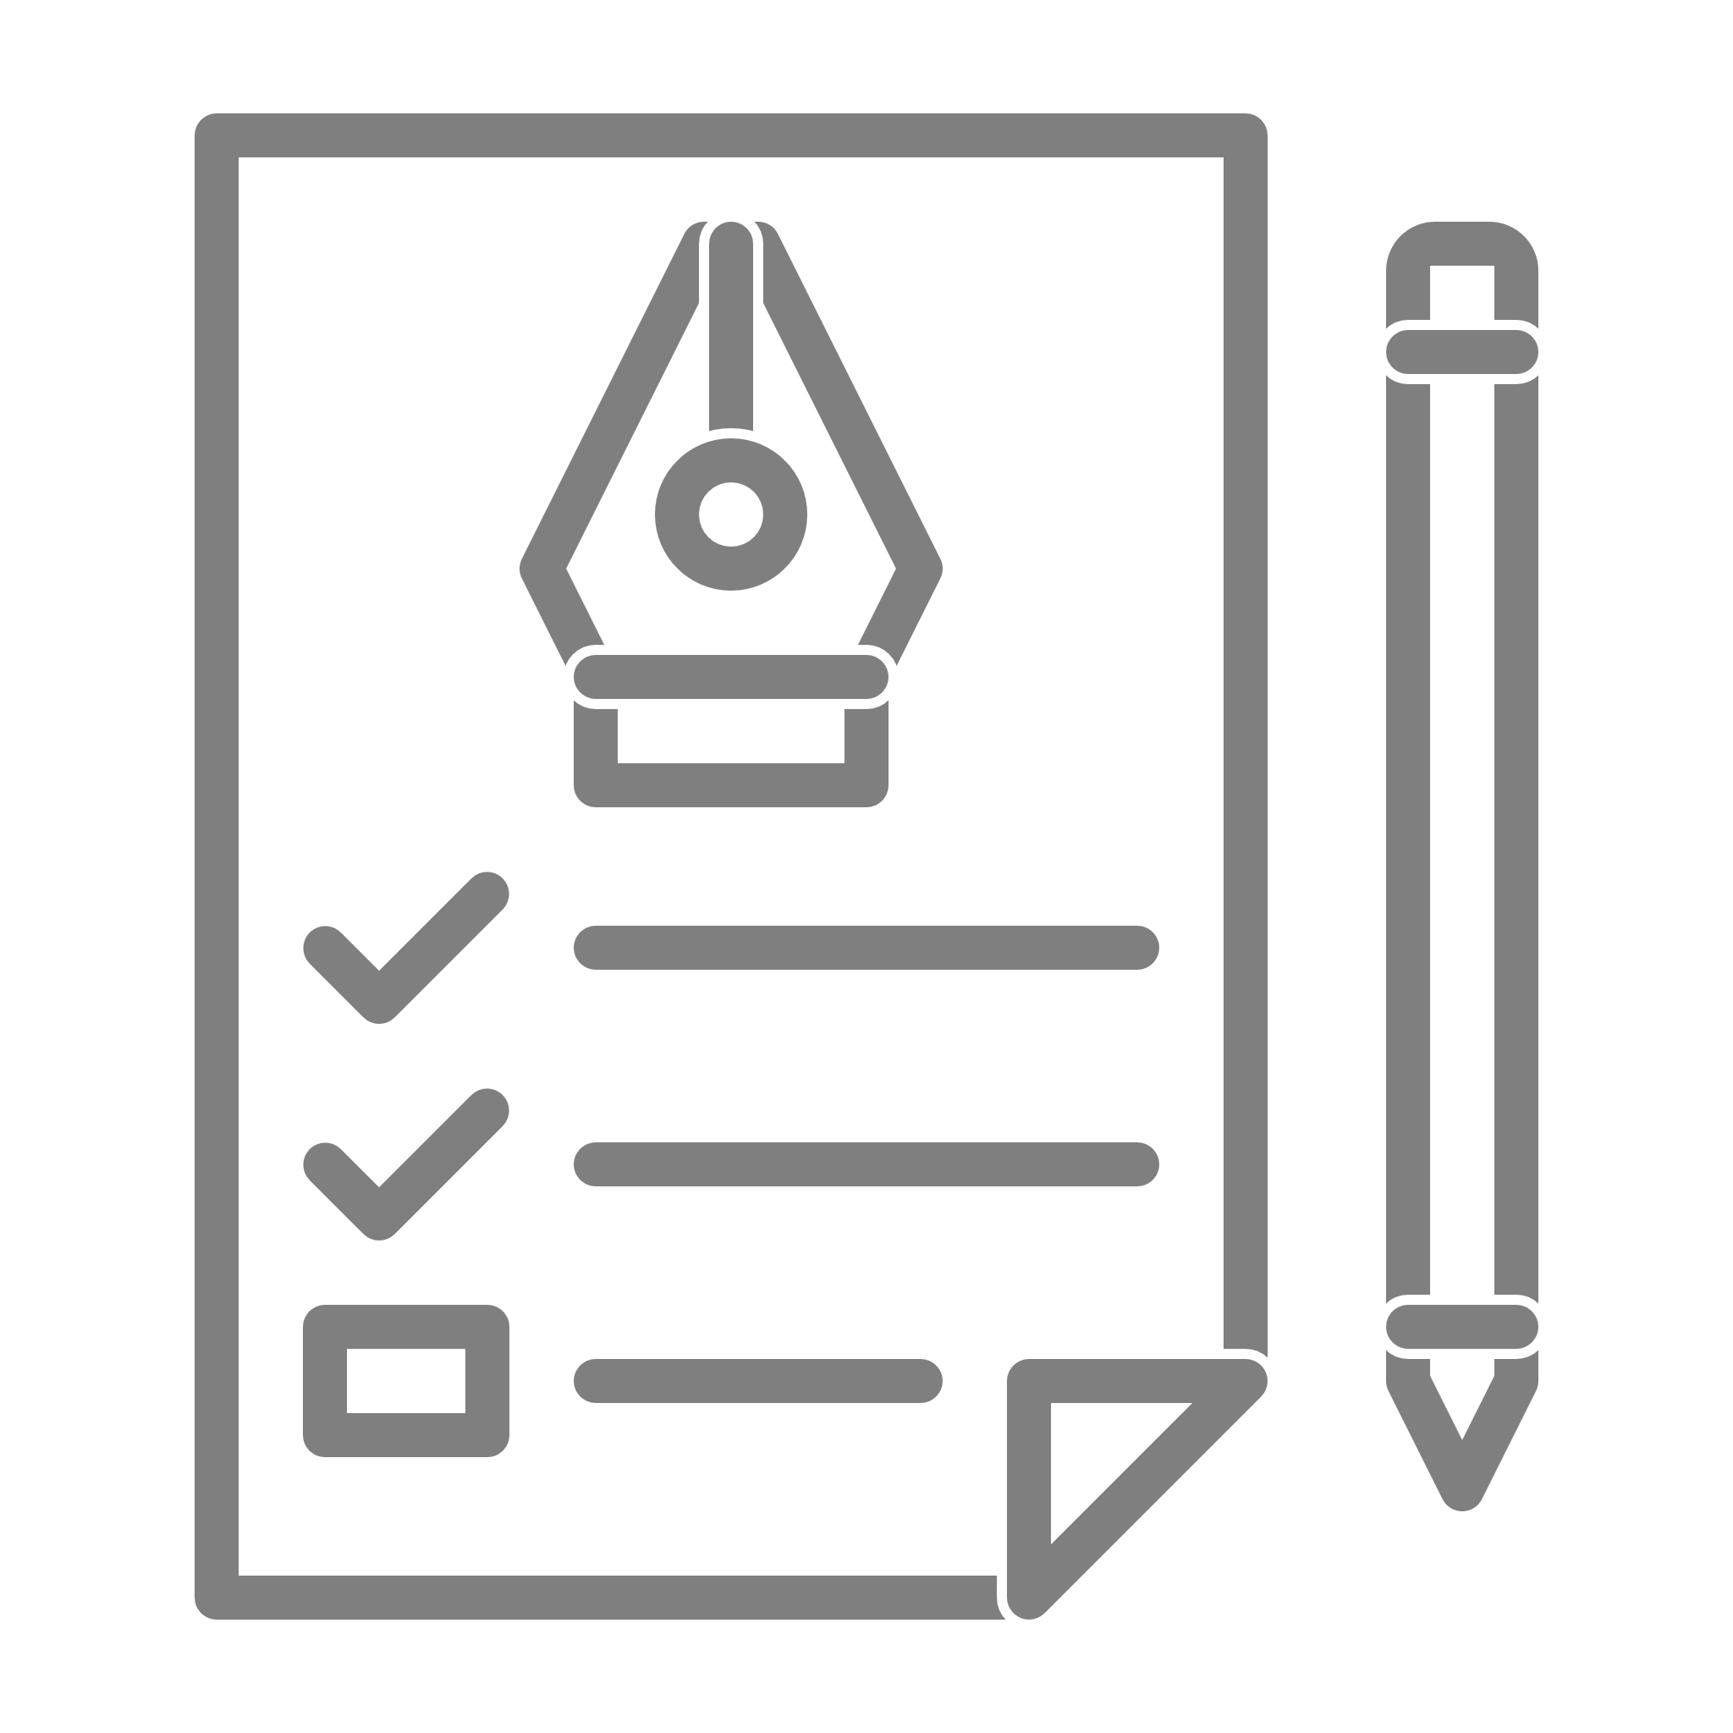


Our approach to helping you
Analytics
Intake
Execution
Delivery
Understanding client needs and objective
Get a deep understanding of the client objectives:
Business questions to answer
Assess available data, data needs if any, critical data elements to take care of
Planned use of the analytics outputs
Structuring approach
Define the best data analytics strategy to answer the client’s business objective
Estimate the time and type of analytics support needed
Agree on the desired type of output
Executing your
Data Analytics projects
Leveraging a full range of analytics capabilities
Preparation
Identifying Data Sources
Extracting and Transferring Data
Metadata & Dictionaries
Merging of various data sources / Adding new data
Assessing Data Quality, handling outliers
Restructuring Data for analysis
Business & Data Under
standing
Agile Metho
dology
Deriving insights
Performing in-depth quality assurance
Analyzing data outputs to derive insights in line with the initial client ask
Handover
Presenting the approach, results and potential limitations
Sharing all documentation and codes
Getting client feedback
Integrating and scaling with clients’ IT Teams
Performing regular model maintenance
Delivery Management
Modeling
Algorithms to answer business question (binary classification, segmentation, forecasting …)
Evaluation and validation of the algorithm
Visualization
Descriptive analysis
Identification of KPIs
Reporting, Dashboards, self-service tools
“Story-telling”

Slide 5
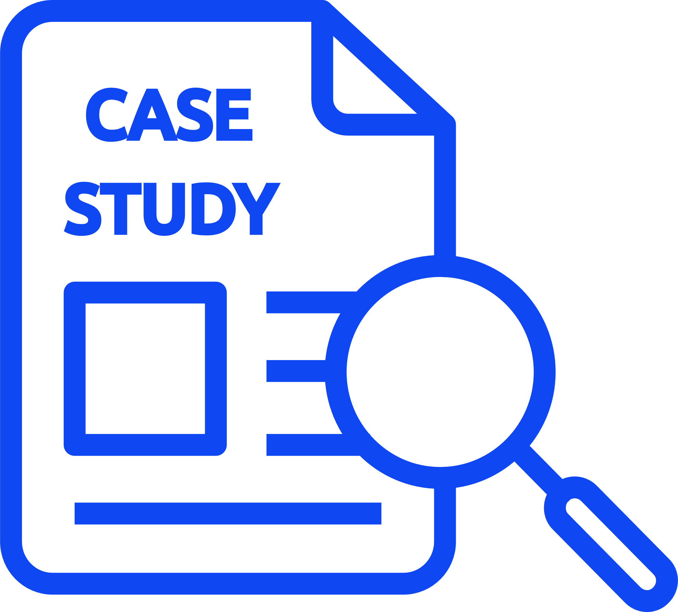


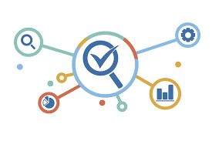





CASE STUDY
Client Challenge
Our Solution
Outcome
Client:
The client wants to have an automatized Human Resource Dashboard to track, analyze and report on HR KPIs.
The firm was looking for:
The company decided to use Infomineo’s Data Analytics service as a solution to cover:
The firm recognized that the quality of the Data Analytics service provided a useful reporting tool resulting in:
A multinational firm
Data Quality & Consistency problems between the various Data sources
Dashboard creation that reflects HR Team needs
During the project, Data were corrected in the ERPs :
Manual files where not used anymore
Data Quality improved by 55% for critical data elements
Effective and quick solution
“I was really impressed by the responsiveness of the team : they came up with a first and quite impressive dashboard proposition within only a couple of days. I also really appreciated the quality of the work; it was really helpful for us to identify the data cleansing needed in our ERP.”
─ Chief Human Capital Officer (Client)
Estimated 1 FTE from the HR department could be reallocated to other tasks
Helped the company to start its Data Transformation
Infomineo has been asked to work with client’s Finance Team to create another dashboard
Smooth integration with its existing ERPs
Lower cost than buying from a specialized company an HR Dashboard tool
Ad-hoc deliverables :
Dictionaries, Creation of Metadata, Data Quality On boarding

Slide 6





Why work with us
Analytics
Combination of Data Analytics and Data Research methodologies
Opportunity to work with a unique professional network
Top-class InfoSec credentials - ISO certified & RGPD Compliance
World class Data Analytics capabilities
Management of specific day-to-day tasks or full end-to-end projects
Continued support in the long run to maintain and adjust solutions
Full compliance with confidentiality and ethics best practices
Adaptability
Multinational, multi-skilled teams allowing you to access top talents across different geographies
Retained model granting maximum flexibility to scale up when needed
Flexibility and scalability
Brainshoring approach: high quality support, critical thinking and business sense…
…provided to our clients from our nearshore locations: Casablanca, Mexico and Cairo
Retainer model granting full dedication to clients and most cost-effective daily/hourly rate
Value added services at a competitive price

